Slide 1





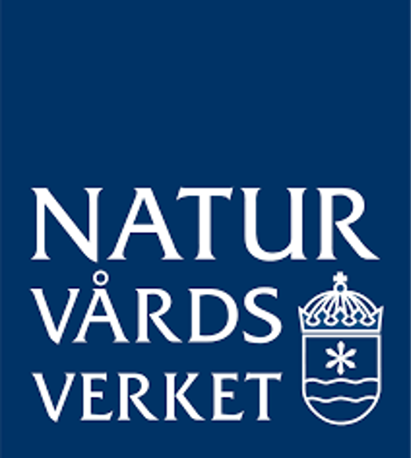
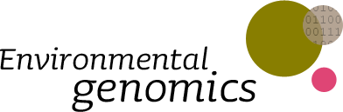
Bacterial and protist plankton diversity dynamics uncovered through DNA-based monitoring in the Baltic Sea area
2025-02-05
Krzysztof T Jurdzinski, Meike AC Latz, Anders Torstensson, Sonia Brugel, Mikael Hedblom, Yue O O Hu, Markus Lindh, Agneta Andersson, Bengt Karlson, Anders F Andersson
Notes:
Hello everyone! My name is Krzysztof Jurdzinski, but you can just call me Kristoff. I am a PhD student at KTH in Anders Andersson’s lab, and the work I will talk about today comes from a collaboration with Swedish Meteorology and Hydrology Institute and Umeå University.
It is a comparative analysis of bacterial and protist plankton diversity, across space and time, in the Baltic Sea area. It is also part of a project in which DNA metabarcoding has been temporarily integrated into Swedish coastline monitoring.

Slide 2
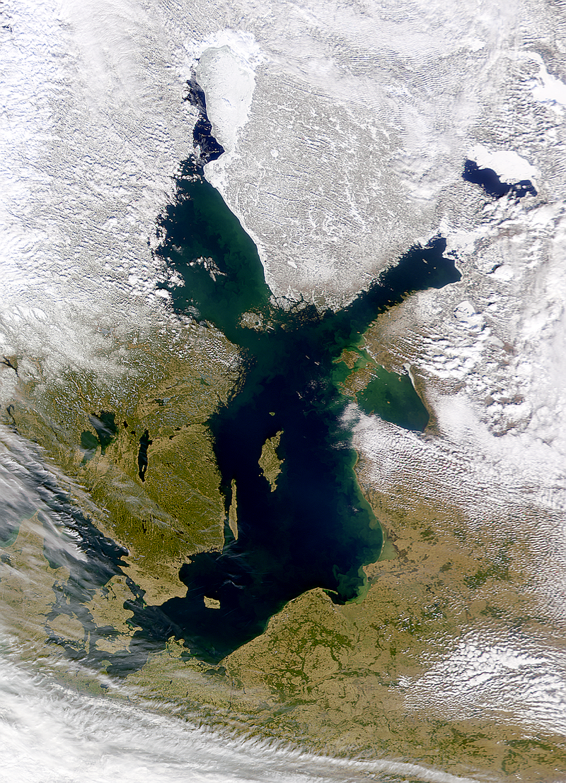


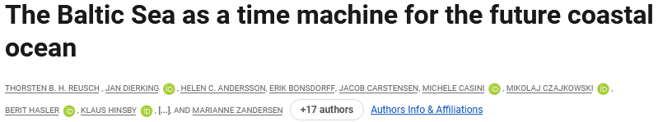
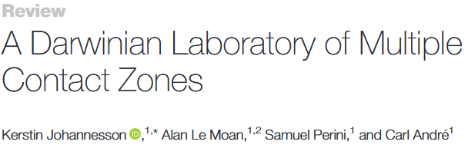
The Baltic Sea area
The Baltic Sea, Kattegat, and Skagerrak
Long history of monitoring
First reports from XIX century
Regular monitoring from the 1980s in Sweden
Multiple environmental gradients
Pronounced salinity gradient
Strong seasonality
Complex spatiotemporal changes in nutrient status
A model coastal ecosystem
SeaWiFS Project, NASA/Goddard Space Flight Center, and ORBIMAGE
Notes:
So, let me first introduce the studied ecosystems. I’ve used the term “Baltic Sea area” in the title of the talk. To be more precise, we are talking here about the Baltic and the adjacent Kattegat and Skagerrak.
This region has a long history of monitoring, with the first reports on microbial plankton from XIX century. Regular monitoring with microscopy started in the 80s in Sweden, and at a similar time in other countries in the region.
Now, this is also an environmentally unique region. It is one of the largest brackish water basins and has a pronounced salinity, which you will hear more about in this talk. The Baltic Sea area also changes drastically around the year, not only due to its climate but also as the nutrient status changes dramatically in both space and time.
Last but not least, the Baltic Sea can be seen as a model coastal ecosystem, both because it has been subject to anthropogenic pressures since very early, as this paper discusses, and because its aforementioned environmental gradients make it a unique place for life to adapt to. As the animal geneticist Leif Andersson once said, “The Baltic Sea is our Galapagos.”

Slide 3
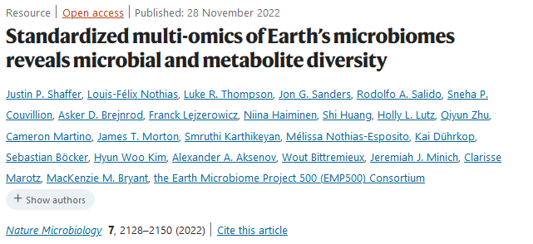
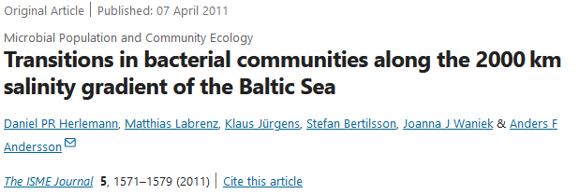
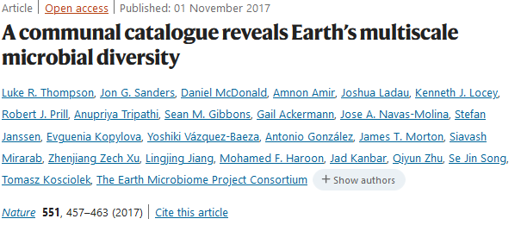
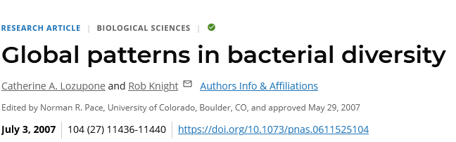
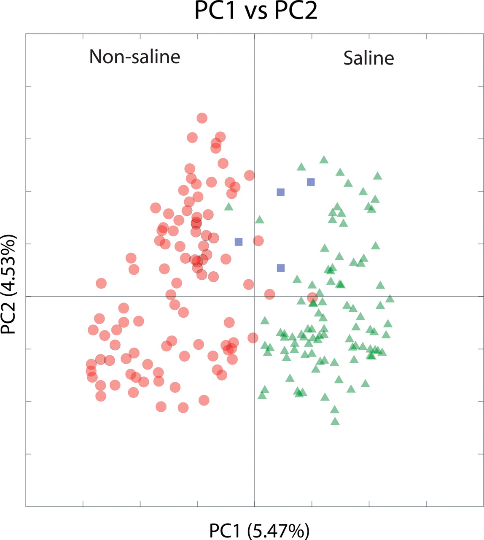
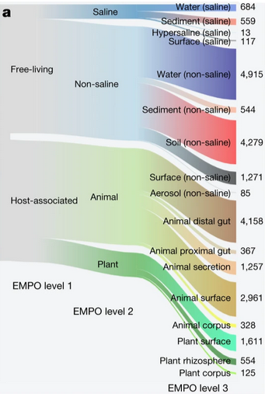
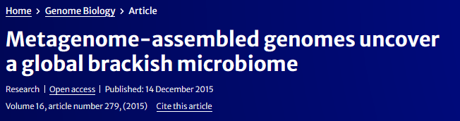
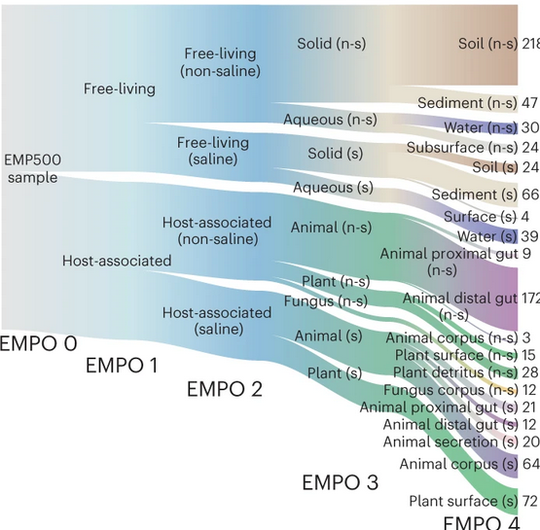

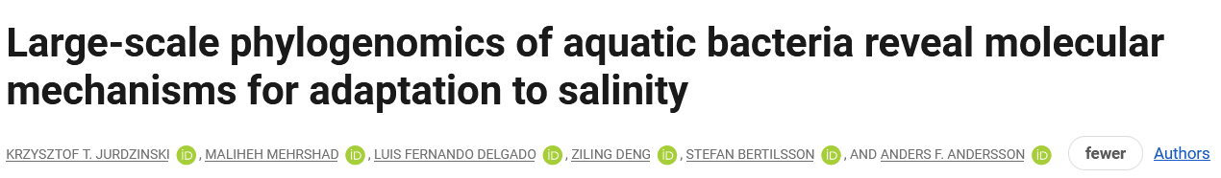
Salinity as the major environmental factor determining the distribution of free-living bacteria
Notes:
The pronounced salinity gradient and recent salinization might well be the most unique thing about the Baltic Sea. It also happens so that salinity seems to have an immense effect on the distribution of bacterial taxa. Since the earliest global surveys of bacterial diversity, it turned up as the major factor influencing community composition. In the following surveys, it remained the strongest factor for free-living bacteria, and even for the host-associated ones. Now, that has been very much based on the division between freshwater and marine environments. Now, what about the brackish waters, characterized by salinities in-between? This is what my supervisor, Anders Andersson, has pioneered. From showing how bacterial communities change across the brackish salinity gradient, through showing that brackish waters hold globally distributed bacterial species distinct from freshwater and marine ones, to uncovering molecular adaptations and evolutionary dynamics of transitions between one salinity regime – for example, brackish – and another – for example, freshwater. And in this study, we also tackle another major microbial group, that is, the single-celled eukaryotes, or protists.

Slide 4
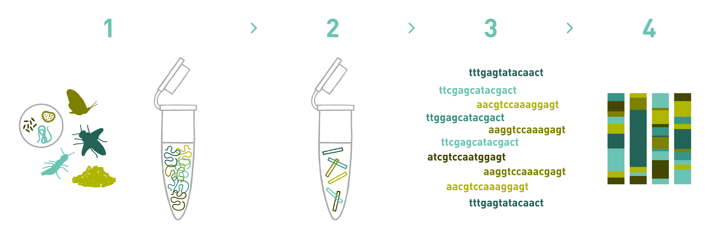
DNA metabarcoding
Shotgun metagenomics
Fragment and sequence all!
Metabarcoding
Amplify marker genes (16S, 18S, ITS, COI…)
Bioinformatic analysis
Detected taxa and their relative abundance (closer to absolute with a spike-in)
Environmental DNA
www.allgenetics.eu
Notes:
Last but not least, all the studies shown on the previous slide used environmental DNA-based methods, and this one is based on DNA metabarcoding. In brief, you take an environmental sample, you isolate the DNA, you amplify a marker gene – you can also just sequence DNA fragments, but this is not what we talk about here – and they you can analyze which taxa were detected and their relative abundance. In this study, we also used synthetic DNA, so-called spike-in, to get more absolute abundance values.

Slide 5
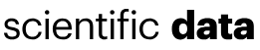
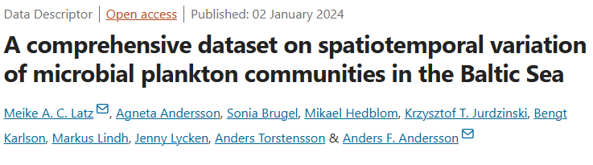
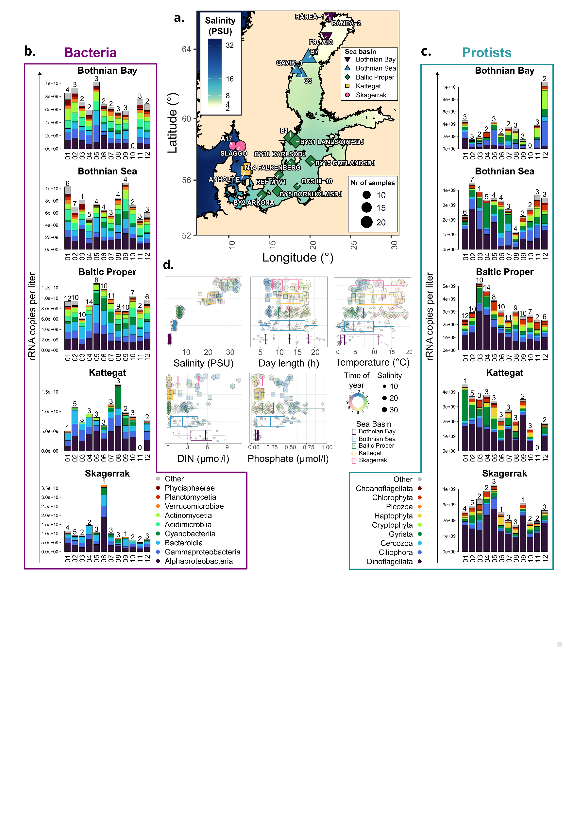
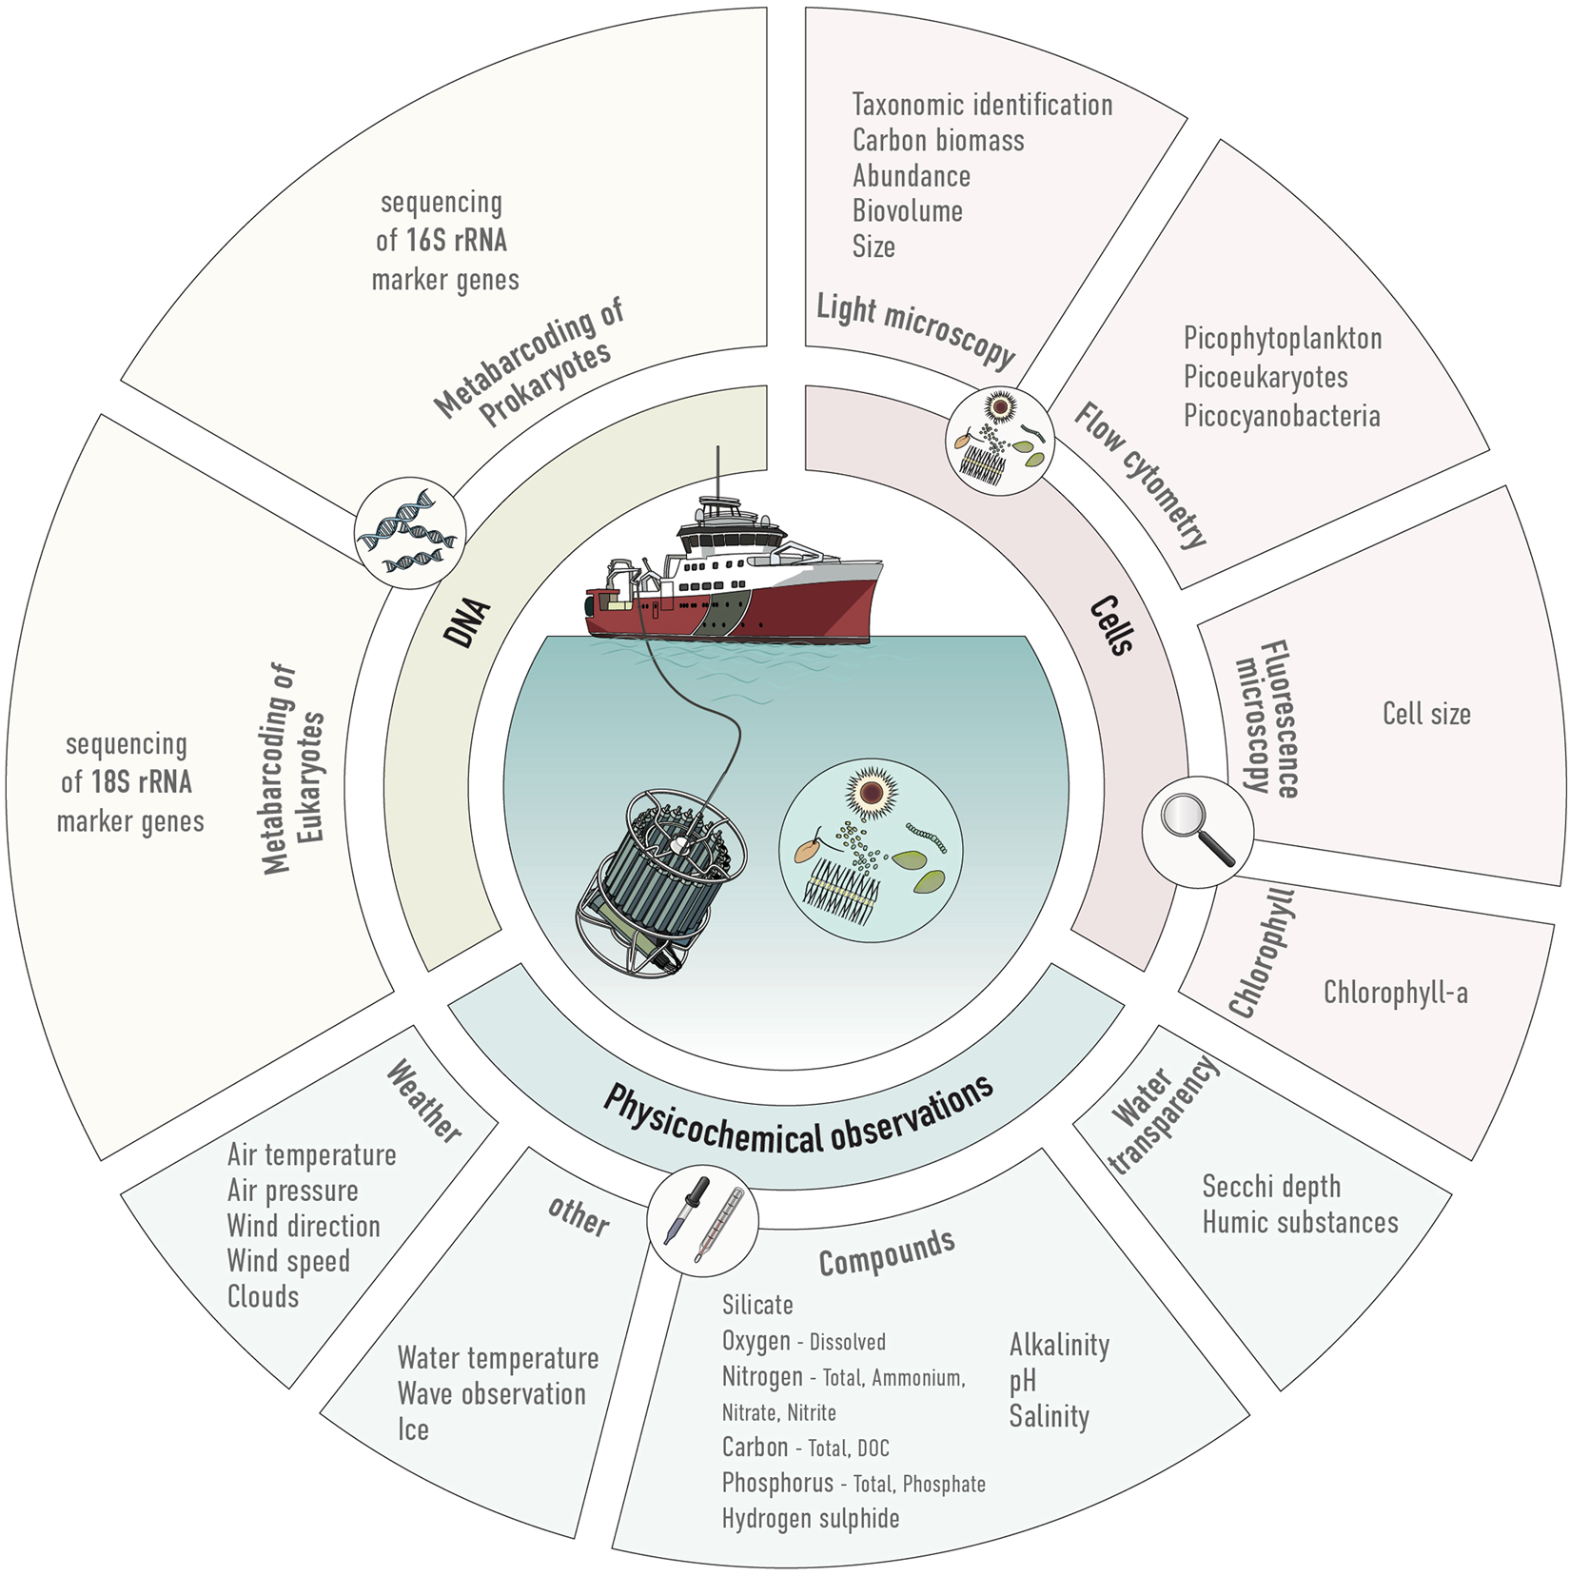

DNA metabarcoding-based monitoring
2019-2020
Notes:
This study is very much based on data we have already made public. This is a dataset spanning more than a year and the full length of Swedish coastline, with 16S rRNA metabarcoding for bacteria, 18S rRNA for eukaryotes, and the monitoring parameters collected along. Microscopy and other cell analyses have also been collected but not analyzed in this study.
Now, to set the stage for the rest of the presentation, I want you to look at the map and notice the large gap in salinity between the Baltic Sea and Kattegat. We will come back to it multiple times

Slide 6
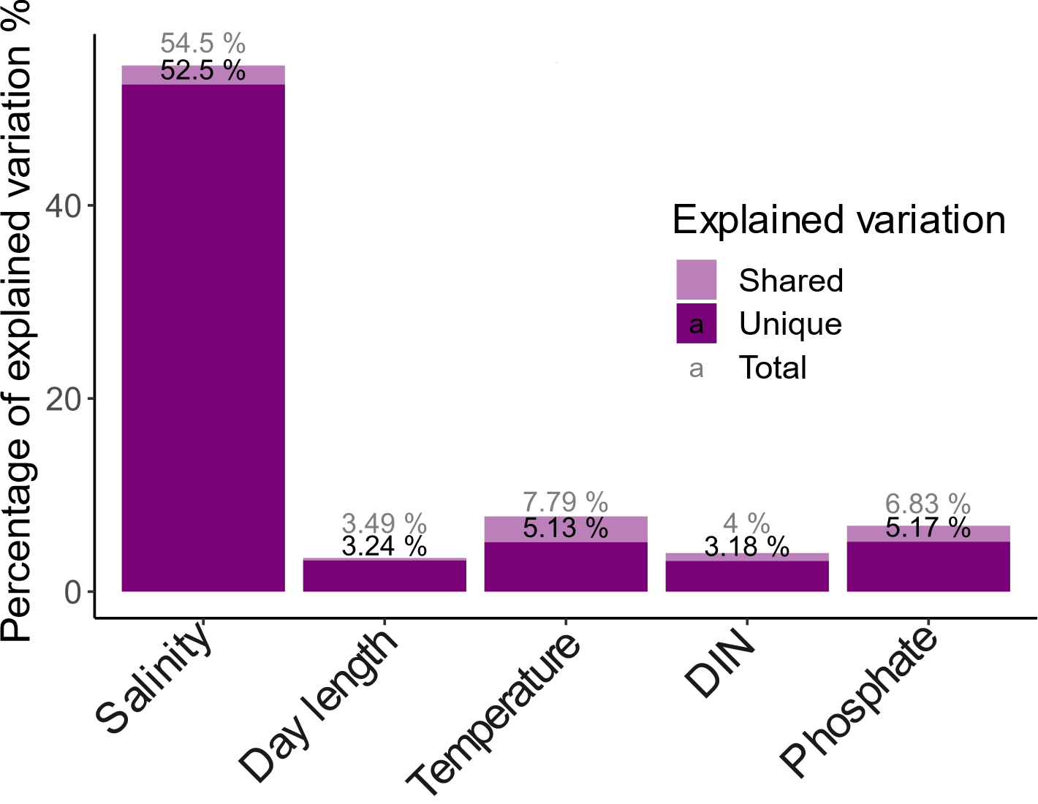
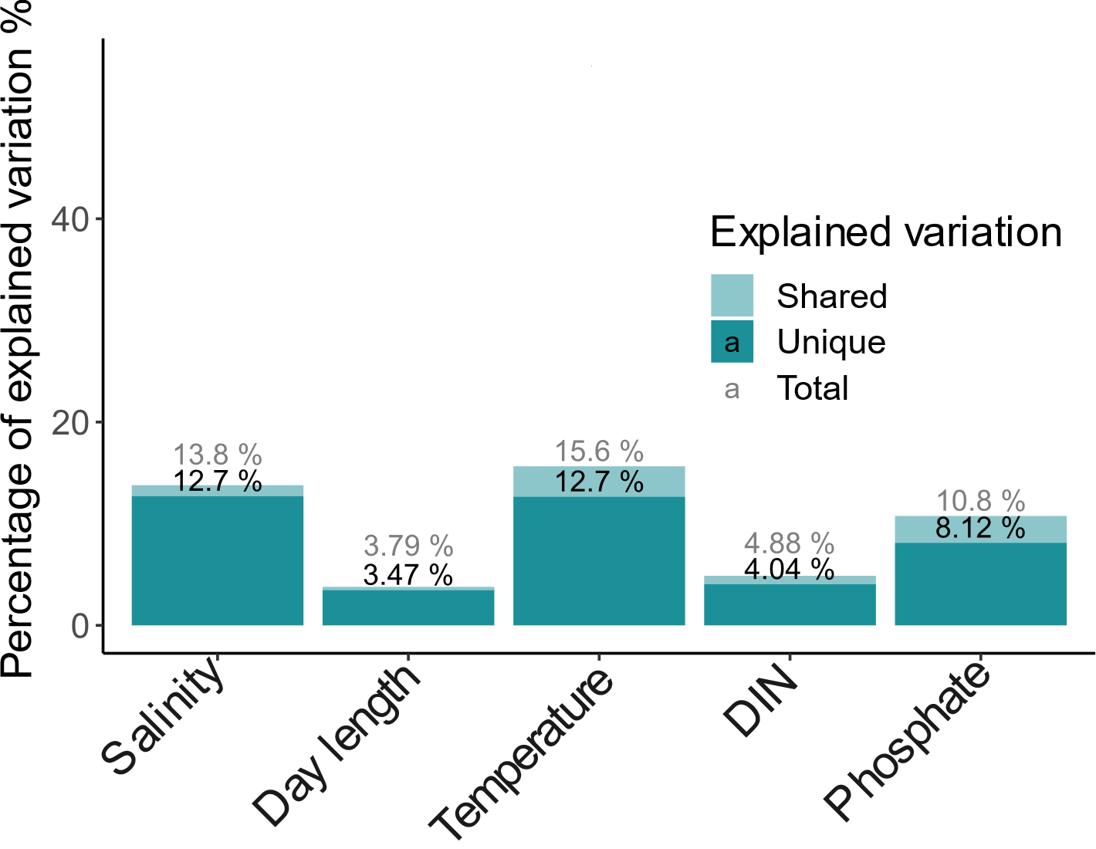
Salinity has a dominant impact on bacterial but not protist community composition
Bacteria
Protists
Notes:
The first thing we look at is beta diversity. How similar are the microbial communities across space in time in the Baltic Sea area? It turns out that, consistent with previous results, bacteria largely follow salinity. However, salinity has a much lower impact on protist communities, despite other factors being at least as influencial as for bacteria.
I will come back to beta diversity more in detail in a moment…

Slide 7
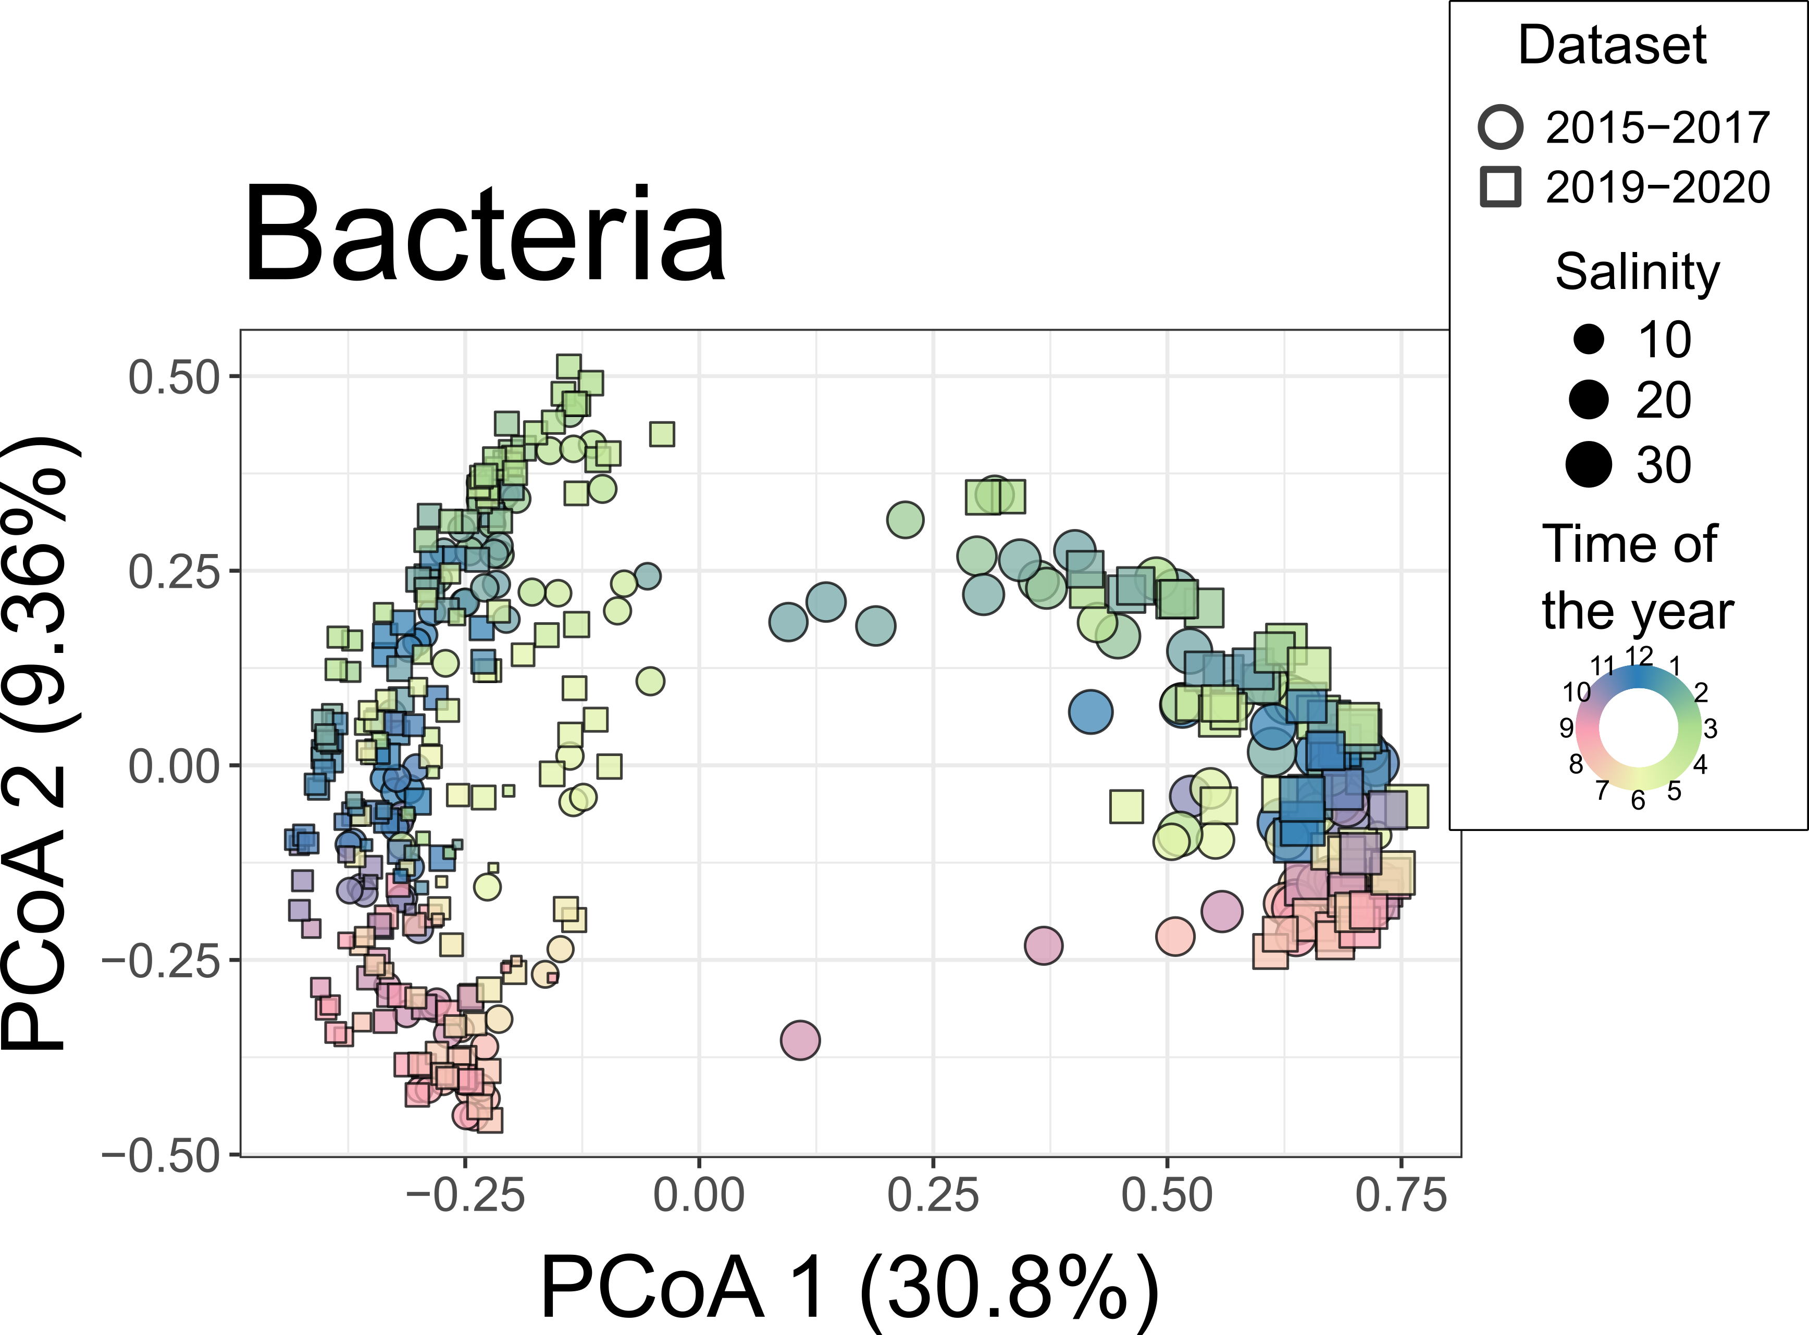
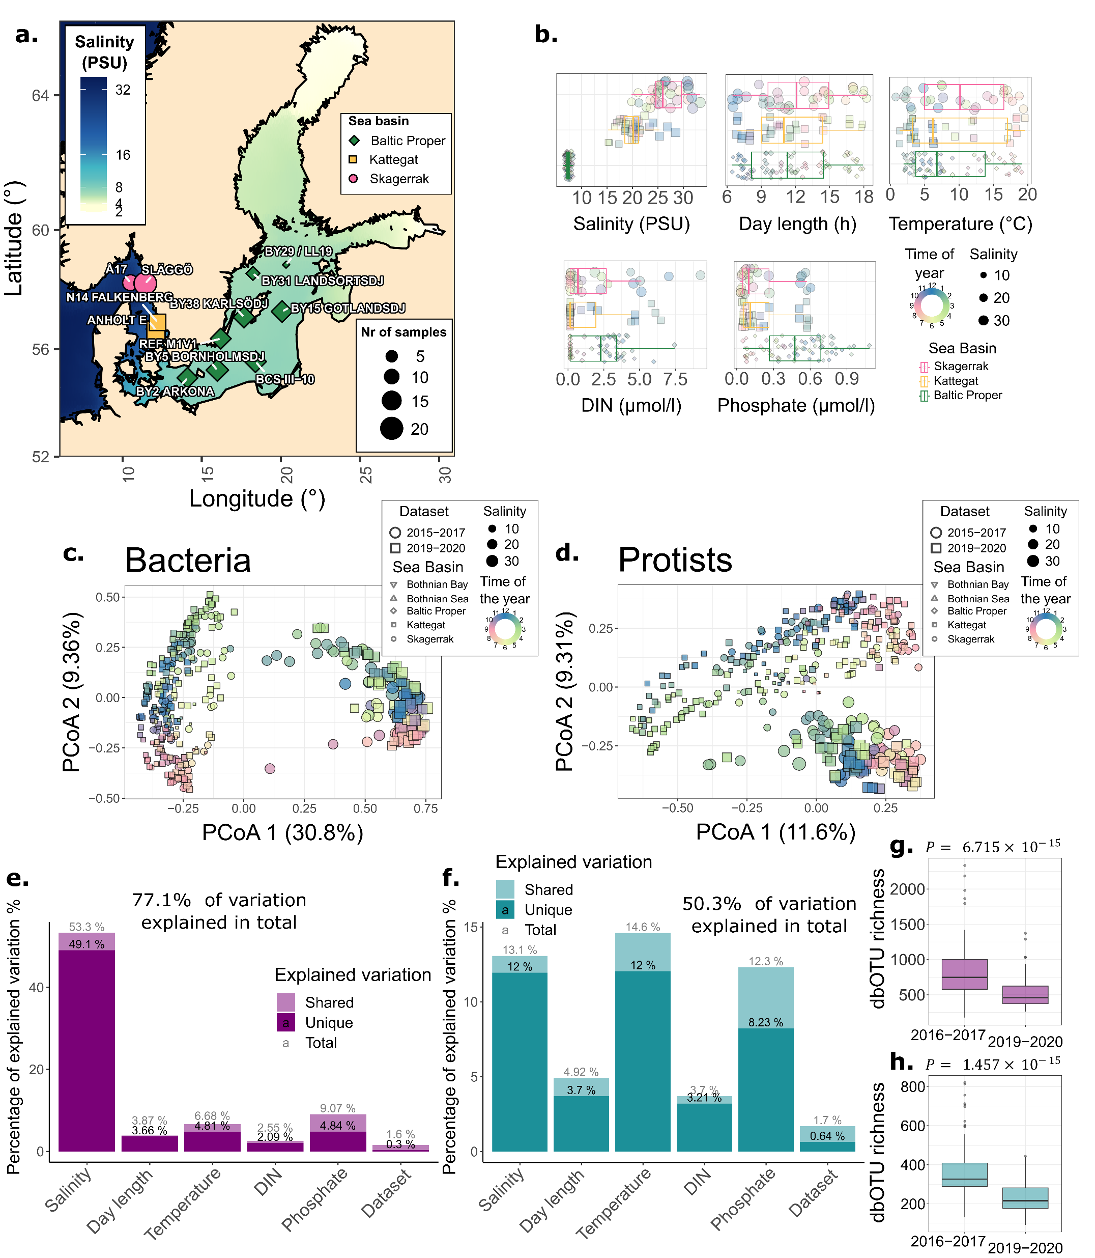


Inter-annual stability in community composition
That surely does not apply to longer time-frames.
2015-2017
Notes:
…bur first let me introduce to you a dataset that is new in this study. So we also performed 16S and 18S metabarcoding retrieved samples from an analogous sampling effort across mainly 2016-2017, with a few samples from 2015. Now, coming back to community composition, but across both datasets. For bacteria, there was a clear separation across the salinity gap, hence a salinity barrier. Protists were much less separated by the salinity barrier. In both cases, there were no apparent differences between the datasets once corrected for environmental context, suggesting a certain degree of stability in community composition across years. Now the first important note is that we know from other research that long-term changes do occur, and we do not deny that. Another is that alpha diversity across the datasets was not so similar, which was likely due to minor technical differences, a precautionary tale for future metanalyses.

Slide 8
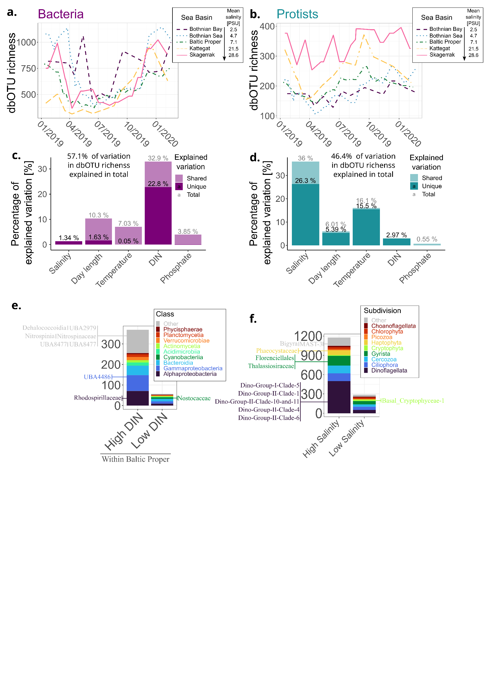
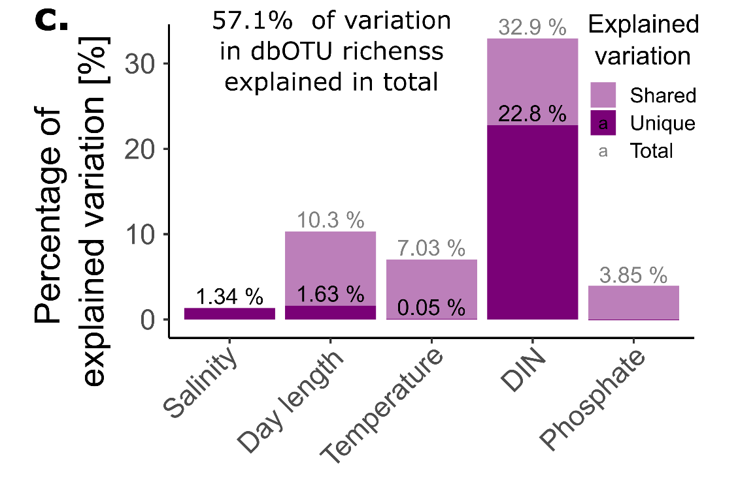
Bacterial alpha-diversity correlates with dissolved inorganic nitrogen availability…
Notes:
Now that allows us to move into alpha diversity. How many lowest-level taxa – called dbOTUs in this case – could we find in a sample? For bacteria, if we just run linear correlation, dissolved inorganic nitrogen by far correlated best with alpha diversity. And we can see that this corresponded to seasonal variation rather than stable differences between the regions (so, each line on this graph is a rolling mean for a region). But was DIN really causing this seasonal vartiation?

Slide 9
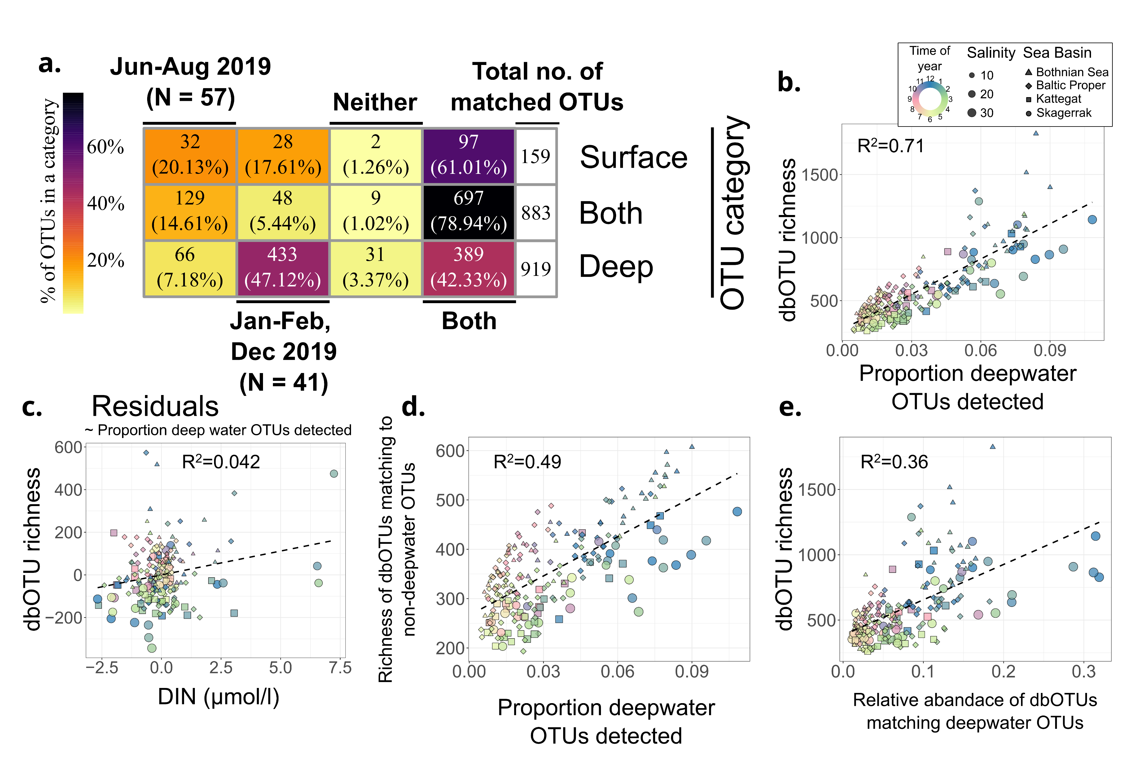
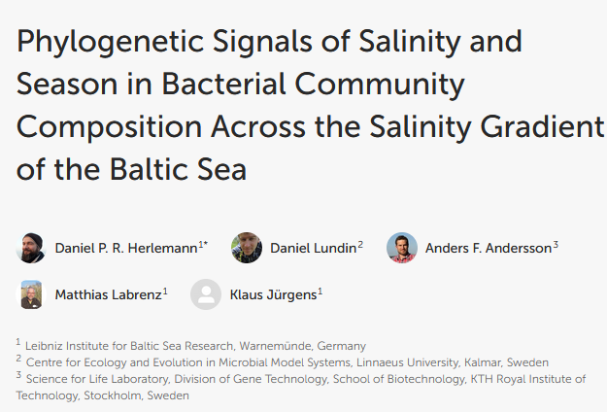
…but that can be explained by convective vertical mixing in winter
Using data from Herlemann et al. 2016
Notes:
A well-discussed confounding factor would be convective mixing, the idea being that it brings extra taxa to the surface from deeper waters. To test that, we used data from yet another previous paper, where they did winter and summer transects with depth profiling. And what we get is that the proportion of deepwater taxa from the previous study found in our surface water samples correlates with alpha diversity much better than any of the physicochemical factors we assessed. What is more, once we correct for the presence of deepwater taxa, the DIN no longer associates with bacterial alpha diversity.

Slide 10
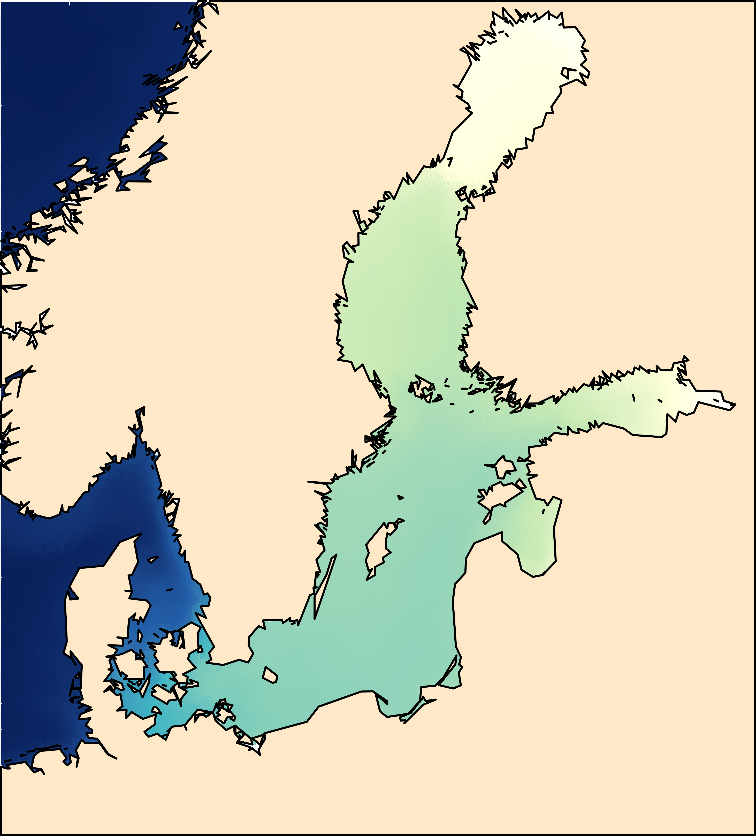
Protists are more diverse in near-marine salinities
Notes:
What about protists? Here, the main pattern was geographic and followed the salinity gradient, with the most saline Kattegat and Skagerrak also being the most diverse regions. Now, this is analogous to the diversity patterns for many animal groups, and we propose an analogous explanation. That is, many marine species adapted to the environment in Kattegat-Skagerrak but fewer to the conditions further down along the salinity gradient in the Baltic Sea. At the same time, the number of adapting marine species was larger than that of freshwater species. Whether this is actually the case, further research will show.

Slide 11
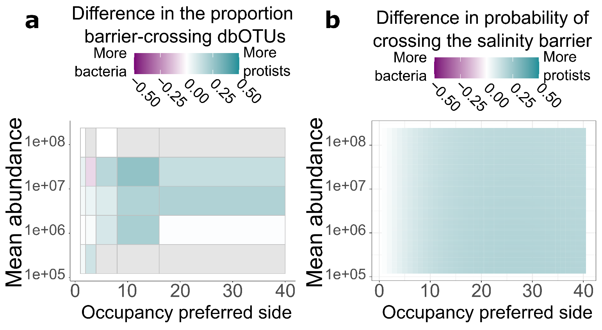
Protist more often cross the salinity barrier
Notes:
So, across the salinity barrier between the Baltic Sea and the Kattegat-Skagerrak, we have seen bigger changes in beta diversity for bacteria, but across the same barrier, protist alpha diversity changed more. Does that mean that abundant bacteria and rare protists are the groups most affected by salinity? Not at all! Across abundance and occupancy values, it was protists that were more likely to cross the salinity barrier, both based on raw data and a Bayesian model. Therefore, both in terms of community composition and the present taxa, salinity affected bacteria more than protists. The remaining question is…

Slide 12
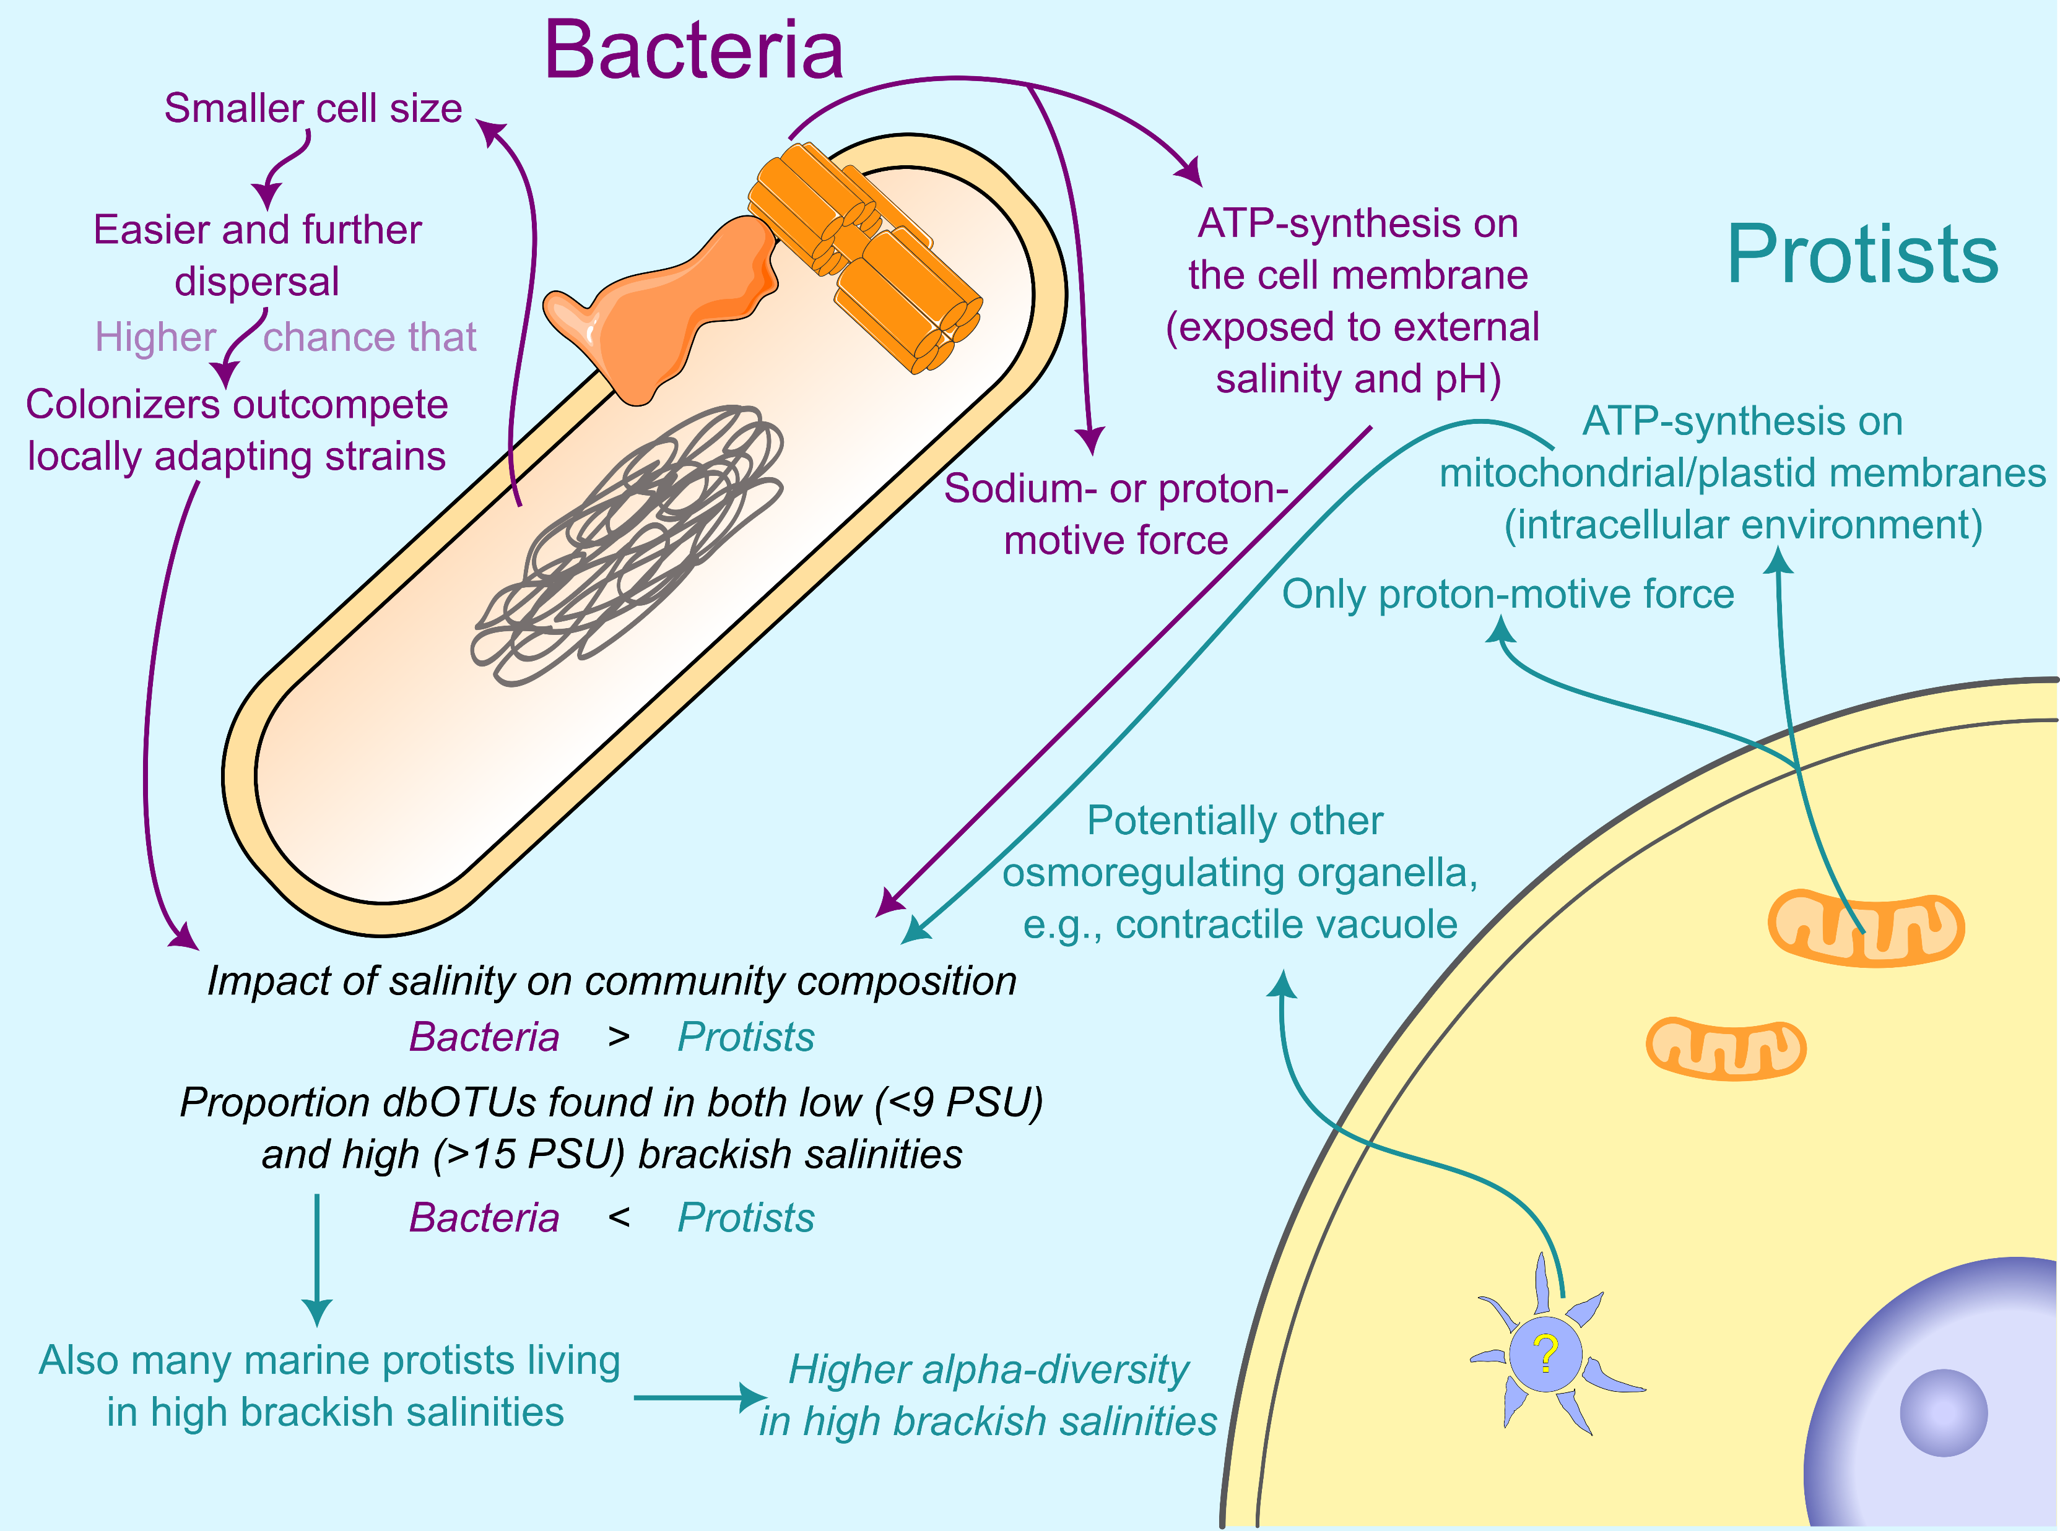
Proposed explanation for protists being ecologically less sensitive to salinity
Further and more frequent dispersal (for bacteria)
Compartmentalization
Colonizers more likely to
outcompete locally
adapting strains
Basic bioenergetic processes disconnected from the cell membrane
Notes:
Why? While there is a long way to well-grounded explanation, we propose plausible potential mechanisms. One idea is that compartmentalization makes adaptation to a different salinity easier for protists. Bacteria have much of their bioenergetics, especially the generation of the proton or sodium gradient for ATP production, happening at their outer membrane. This is a complex system strongly affected by salinity, and adaptation of it would pose a major challenge. Analogous processes in the eukaryotic cell happen across internal membranes and are not much affected by the external environment. In addition, bacteria have been shown to disperse further and more frequently, which is consistent with them just being smaller as per particulate physics. That would mean that after the salinity changes in an environment, local bacterial strains stand little chance to adapt, as they are likely to be outcompeted by colonizers already adapted to the new conditions. Now whether these explanations stand scrutiny is yet to be shown, and we propose some ways to test them in our…

Slide 13
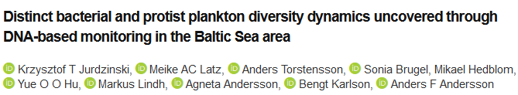

Conclusions
Protists are ecologically less sensitive to salinity, based on:
changes in community composition;
probability a lineage is present in high and low brackish salinities.
Compartmentalization and dispersal limitations might explain these differences.
Winter convective mixing brings deepwater bacteria to the surface and increases alpha diversity.
Protists are more diverse in the near-marine Kattegat-Skagerrak than in the Baltic Sea.
Notes:
…preprint, which you can find on the right-hand side of the slide. Meanwhile, I give space to your questions and comments, and I leave the conclusion slide as a reminder of the main themes in the study. Thank you for your attention!

